Slide 1

DAYALEKTOR
Belchez, Maica L. Carpio, Aira Joyce A. Gardon, Jana Marie G. Haboc, Florence Gail G.

Slide 2
Overview
Lean Canvas
Business Startup Cost
Revenue Projection
Online Surveys

Slide 3
Lean Canvas

Slide 4

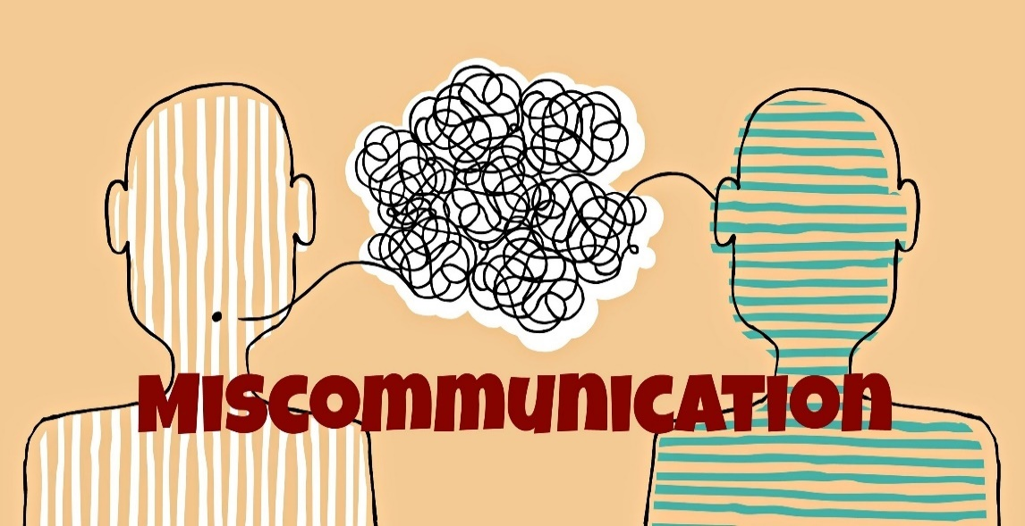
Problems

Slide 5
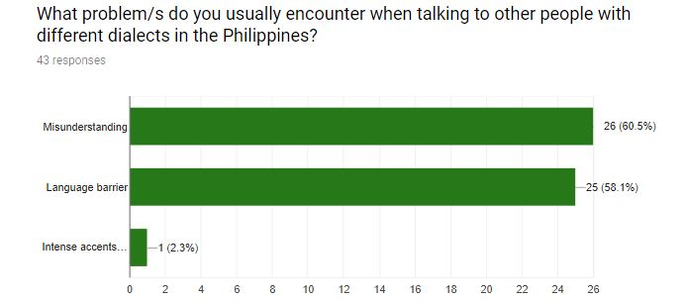

Slide 6
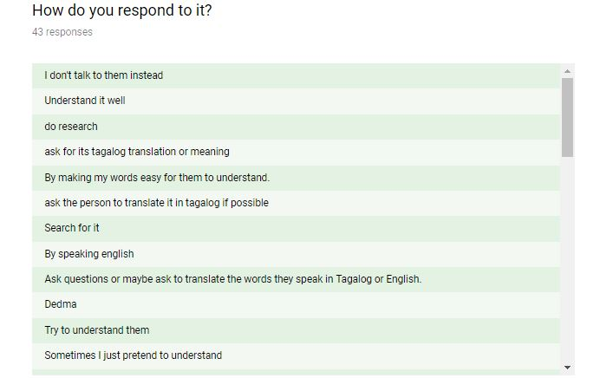
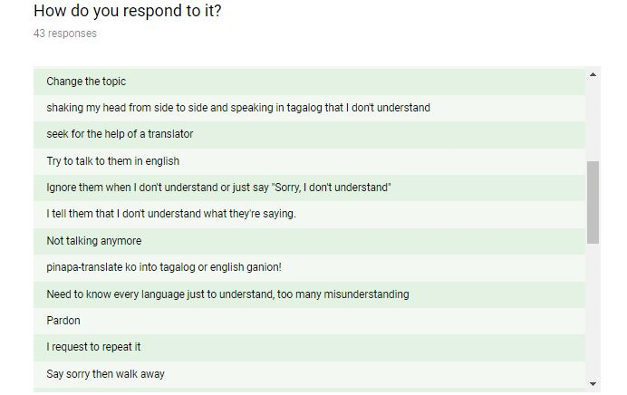
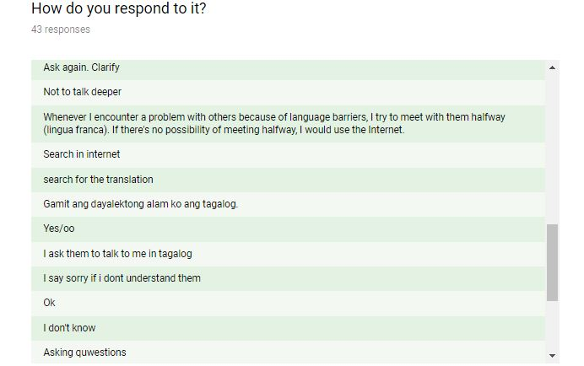
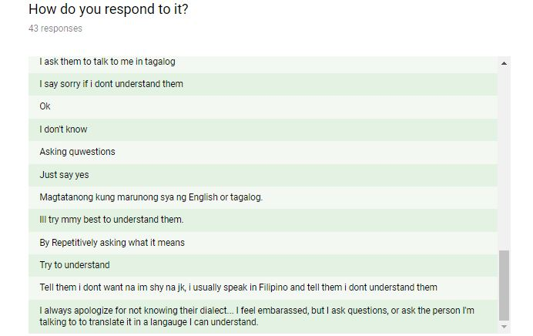

Slide 7



Solutions
Notes:
No more language barrier, Improve communication, lessen misunderstanding

Slide 8
Features
Philippine Dialects Translator
Offline Vocabulary Library
Word of the Day
Delegated Correction

Slide 9
Situational Benefits
Improve vocabulary and check pronunciation
Build self-confidence in talking with other people who speak different dialects

Slide 10
Marketing Message
“NEVER GET LOST IN TRANSLATION”

Slide 11
Channels
Social Networks
Blog
Advertisement
Email
Website

Slide 12
Customer Segments
Filipinos and Foreigners
Male and Female users
18 years old and above
Tourists and Travelers

Slide 13
Cost Structure
Mobile Development
Marketing
Advertising
Salaries
Utilities

Slide 14
Revenue Streams
Stakeholders
Paid Customers
Development Fees

Slide 15
Business Startup Cost

Slide 16
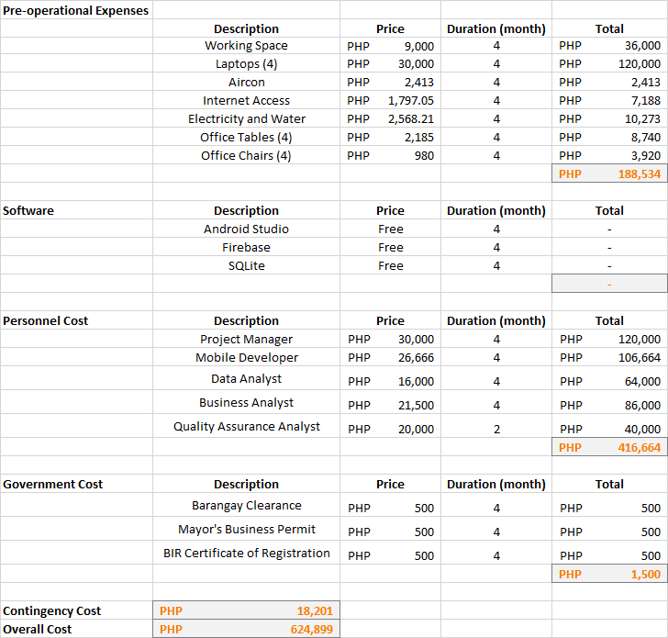

Slide 17
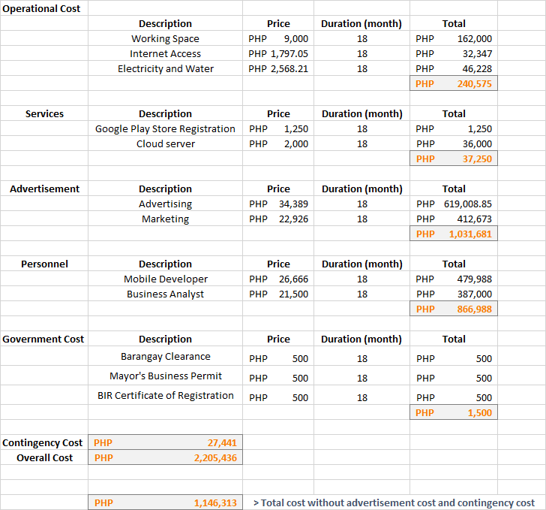

Slide 18
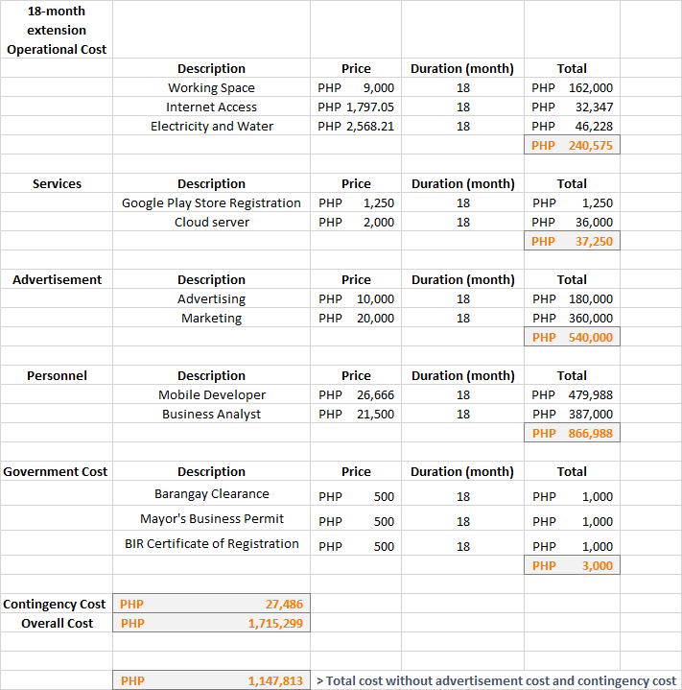

Slide 19


Slide 20
Travel Agency
Travel Company Website
D.O.T
Social Media Ads
Influencer’s Blog
Customer’s Feedback
Sales Funnel

Slide 21
Revenue Projection

Slide 22
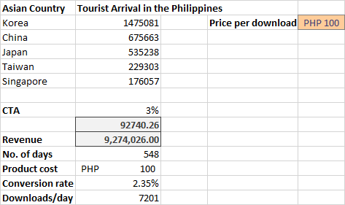

Slide 23
Online Surveys

Slide 24
Part 1 – Pain Points

Slide 25
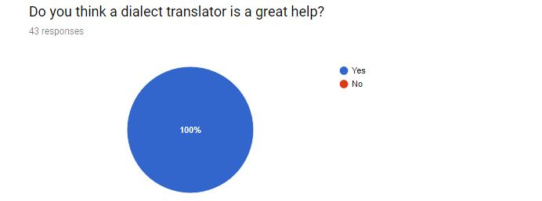
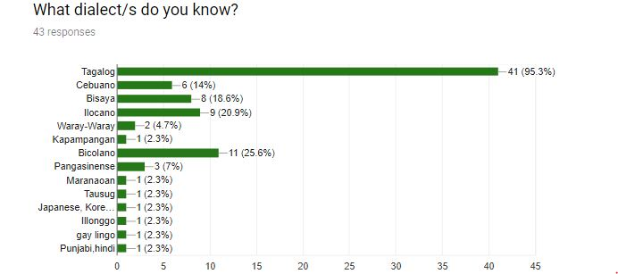

Slide 26
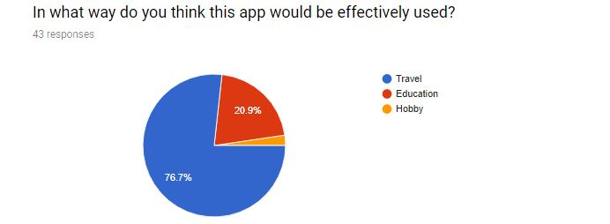
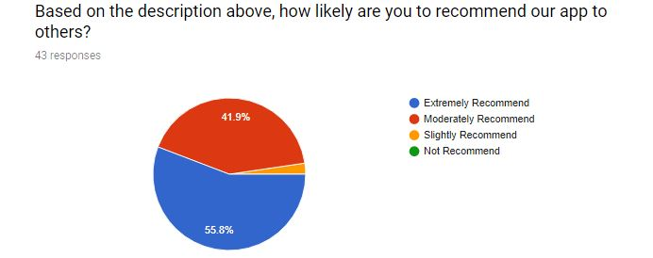

Slide 27
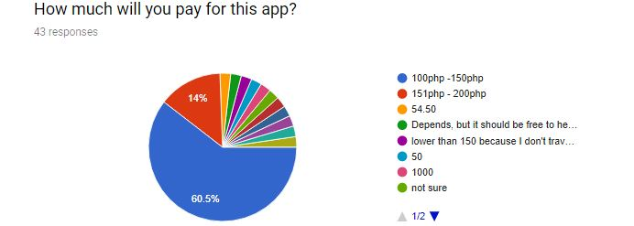
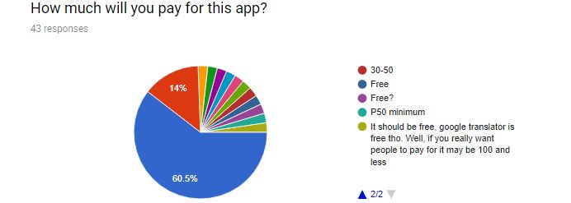

Slide 28
Part 2 – Features

Slide 29
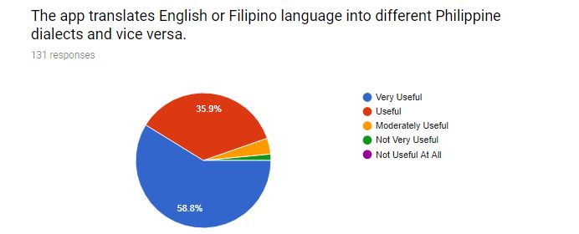
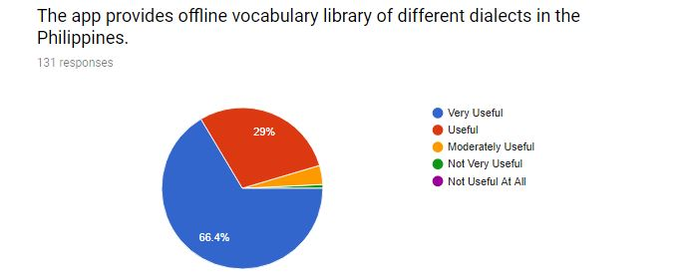

Slide 30
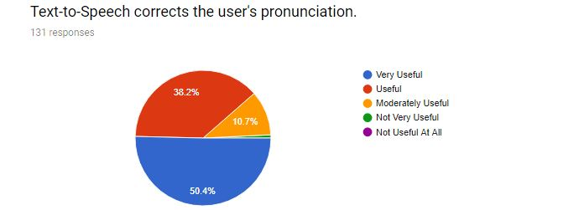
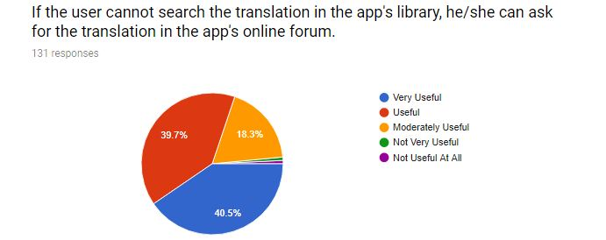

Slide 31
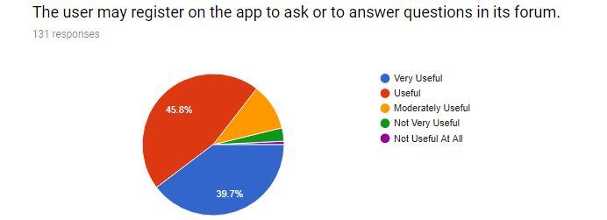
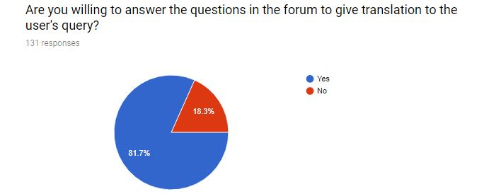

Slide 32
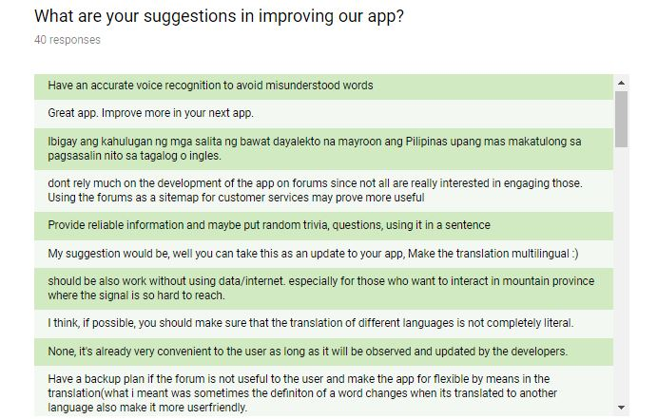
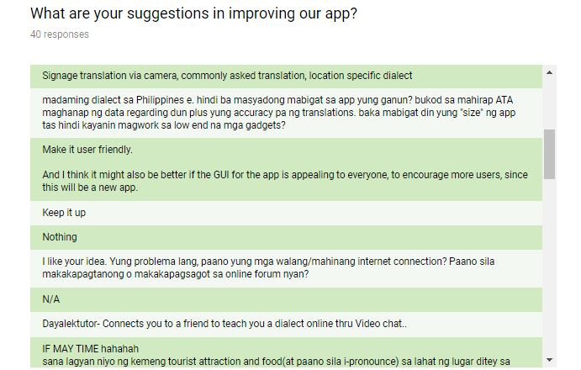
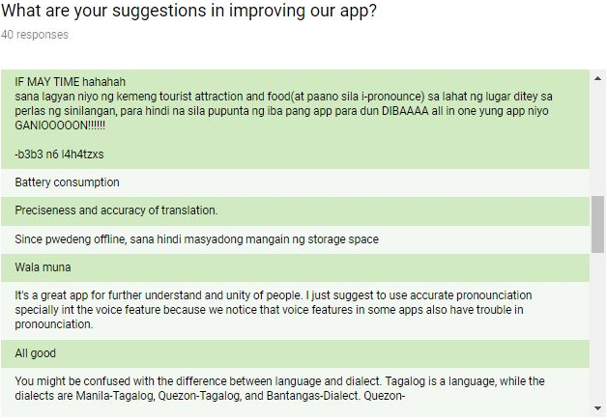

Slide 33
